Slide 1

Introduction to algorithms
Seminar 7
w/c:15 November 2021

Slide 2
Draw binary trees
node(node(leaf,3,leaf),6,node(leaf,1,node(leaf,5,leaf)))
6
3
1
5
node(node(node(leaf,8,leaf),7,node(node(leaf,6,leaf),1,node(leaf,2,leaf))),5,node(leaf,3,leaf))
5
7
3
8
1
6
2

Slide 3
Left, right, root
T:
5
7
3
8
1
9
root(T)=
5
7
6
2
root(left(T))=
root(right(T))=
3
root(right(right(T)))=
9
root(left(right(left(T))))=
6
left(left(right(left(T))))=
leaf

Slide 4
Binary tree size vs tree height
n=size()
The total number of nodes in a BT
h=height()
The number of generations in a BT
How many binary trees can be made with n distinct nodes?
minimal binary tree with 3 nodes
h=2
h=3
h=3

Slide 5
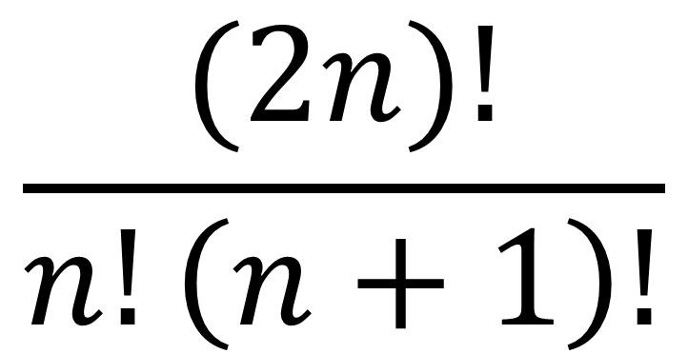
Binary tree size vs tree height
n=size()
The total number of nodes in a BT
h=height()
The number of generations in a BT
How many binary trees can be made with n distinct nodes?
$$\frac{(2n)!}{n!\left(n+1\right)!}$$

Slide 6




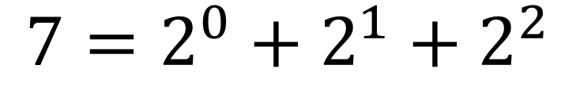
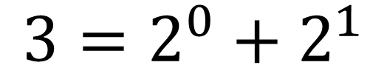
Minimal binary tree
What is the height of shortest BT can be made with n distinct nodes?
0
$$2^{0}$$
n=3
$${3=2^{0}+2}^{1}$$
1
$$2^{1}$$
Level 0
Level 1
Level 2
$$h_{m}=\left\lfloor \log_{2}{n}\right\rfloor +1$$
$${n=2^{0}+2}^{1}+2^{2}+⋯$$
n=7
1
how many terms?
2
$${7=2^{0}+2}^{1}+2^{2}$$
4

Slide 7
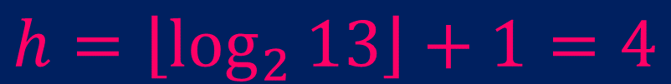

Minimal binary tree
What is the height of shortest BT can be made with n distinct nodes?
n=13
$$h=\left\lfloor \log_{2}{13}\right\rfloor +1=4$$
$$h_{m}=\left\lfloor \log_{2}{n}\right\rfloor +1$$

Slide 8
Recursive BT traversal
Recursively go through left and right subtrees
Recursion STOPS when we hit leaf!
Base case

Slide 9
Tree size - algorithm
TASK: count the total number of nodes in a binary tree
Algorithm: size(binTree)
Requires: a binary tree (BT)
Returns: a positive integer n≥0 (number of nodes)
1. if isLeaf(binTree) then
2. return 0 //base case
3. else
4. return 1+size(left(binTree))+1+size(right(binTree)) //recursive call
5. endif
Correct?

Slide 10
Tree size - algorithm
TASK: count the total number of nodes in a binary tree
Algorithm: size(binTree)
Requires: a binary tree (BT)
Returns: a positive integer n≥0 (number of nodes)
1. if isLeaf(binTree) then
2. return 0 //base case 1
3. else
4. return 1+size(left(binTree))+size(right(binTree)) //recursive call
5. endif

Slide 11
Tree size – trace
x
isLeaf=FALSE
size(left(T))+size(right(T))+1
x
x
size(left(T))+size(right(T))+1
size(left(T))+size(right(T))+1
x
x
x
x
x
x

Slide 12
Tree size – trace
x
isLeaf=FALSE
size(left(T))+size(right(T))+1
x
x
size(left(T))+size(right(T))+1
size(left(T))+size(right(T))+1
size(left(T))+ 0 +1
0 +size(right(T))+1
x
x
x
x
x
x

Slide 13
Tree size – trace
x
isLeaf=FALSE
size(left(T))+size(right(T))+1
x
x
size(left(T))+size(right(T))+1
size(left(T))+size(right(T))+1
size(left(T))+ 0 +1
0 +size(right(T))+1
x
x
size(left(T))+size(right(T))+1
size(left(T))+size(right(T))+1
x
x
x
x

Slide 14
Tree size – trace
x
isLeaf=FALSE
size(left(T))+size(right(T))+1
x
x
size(left(T))+size(right(T))+1
size(left(T))+size(right(T))+1
size(left(T))+ 0 +1
0 +size(right(T))+1
x
x
size(left(T))+size(right(T))+1
size(left(T))+size(right(T))+1
x
x
x
x
size(left(T))+size(right(T))+1
size(left(T))+size(right(T))+1
size(left(T))+size(right(T))+1
size(left(T))+size(right(T))+1

Slide 15
Tree size – trace
x
isLeaf=FALSE
size(left(T))+size(right(T))+1
x
x
size(left(T))+size(right(T))+1
size(left(T))+size(right(T))+1
size(left(T))+ 0 +1
0 +size(right(T))+1
x
x
size(left(T))+size(right(T))+1
size(left(T))+size(right(T))+1
x
x
x
x
size(left(T))+size(right(T))+1
size(left(T))+size(right(T))+1
size(left(T))+size(right(T))+1
isLeaf=TRUE
size(left(T))+size(right(T))+1
Base case

Slide 16
Tree size – trace
x
isLeaf=FALSE
size(left(T))+size(right(T))+1
x
x
size(left(T))+size(right(T))+1
size(left(T))+size(right(T))+1
size(left(T))+ 0 +1
0 +size(right(T))+1
x
x
size(left(T))+size(right(T))+1
size(left(T))+size(right(T))+1
x
x
x
x
(0)+(0)+1
(0)+(0)+1
(0)+(0)+1
isLeaf=TRUE
(0)+(0)+1

Slide 17
Tree size – trace
x
isLeaf=FALSE
size(left(T))+size(right(T))+1
x
x
size(left(T))+size(right(T))+1
size(left(T))+size(right(T))+1
size(left(T))+ 0 +1
0 +size(right(T))+1
x
x
size(left(T))+size(right(T))+1
size(left(T))+size(right(T))+1
x
x
x
x
(0)+(0)+1
(0)+(0)+1
(0)+(0)+1
isLeaf=TRUE
(0)+(0)+1

Slide 18
Tree size – trace
x
isLeaf=FALSE
size(left(T))+size(right(T))+1
x
x
size(left(T))+size(right(T))+1
size(left(T))+size(right(T))+1
size(left(T))+ 0 +1
0 +size(right(T))+1
x
x
(0+0+1)+ (0+0+1)+1
(0+0+1)+ (0+0+1)+1
x
x
x
x
(0)+(0)+1
(0)+(0)+1
(0)+(0)+1
isLeaf=TRUE
(0)+(0)+1

Slide 19
Tree size – trace
x
isLeaf=FALSE
size(left(T))+size(right(T))+1
x
x
size(left(T))+size(right(T))+1
size(left(T))+size(right(T))+1
(3)+ 0 +1
0 + (3) +1
x
x
(0+0+1)+ (0+0+1)+1
(0+0+1)+ (0+0+1)+1
x
x
x
x
(0)+(0)+1
(0)+(0)+1
(0)+(0)+1
isLeaf=TRUE
(0)+(0)+1

Slide 20
Tree size – trace
x
isLeaf=FALSE
=9
(4) +(4) +1
x
x
(3)+ 0 +1
0 + (3) +1
x
x
(0+0+1)+ (0+0+1)+1
(0+0+1)+ (0+0+1)+1
x
x
x
x
(0)+(0)+1
(0)+(0)+1
(0)+(0)+1
isLeaf=TRUE
(0)+(0)+1

Slide 21
Tree height – trace
x
1
1
x
x
1
x
x
1
1
1
x
x
1+1
x
1
1+1+1
1+1+1+1

Slide 22
Homework
Write a recursive algorithm that computes the height of a binary tree.

Slide 23
Searching for a node in a binary tree
1
searchBT(5,tree)
1==5
NO
5 is either on the left OR right subtree
4
3
2
8
9
0
6
5

Slide 24
Searching for a node in a binary tree
1
searchBT(5,tree)
1==5
NO
5 is either on the left OR right subtree
4
3
4==5 || 3==5
NO
5 is either on the left OR right subtree
2
8
9
0
6
5

Slide 25
Searching for a node in a binary tree
1
searchBT(5,tree)
1==5
NO
5 is either on the left OR right subtree
4
3
4==5 || 3==5
NO
5 is either on the left OR right subtree
2==5 || FALSE
||
FALSE || 8==5
2
8
9
0
6
5

Slide 26
Searching for a node in a binary tree
1
searchBT(5,tree)
1==5
NO
5 is either on the left OR right subtree
4
3
4==5 || 3==5
NO
5 is either on the left OR right subtree
2==5 || FALSE
||
FALSE || 8==5
2
8
9==5 || 0==5
||
6==5 || 5==5
9
0
6
5
FALSE || FALSE
||
FALSE || TRUE
FALSE || FALSE
||
FALSE || TRUE
FALSE
||
TRUE
TRUE

Slide 27
homework
Write a recursive algorithm that searches for a node value in a binary tree.
searchBT(x,binTree)
What is the time complexity?
What is the worst case?
What is the best case?

